Slide 1
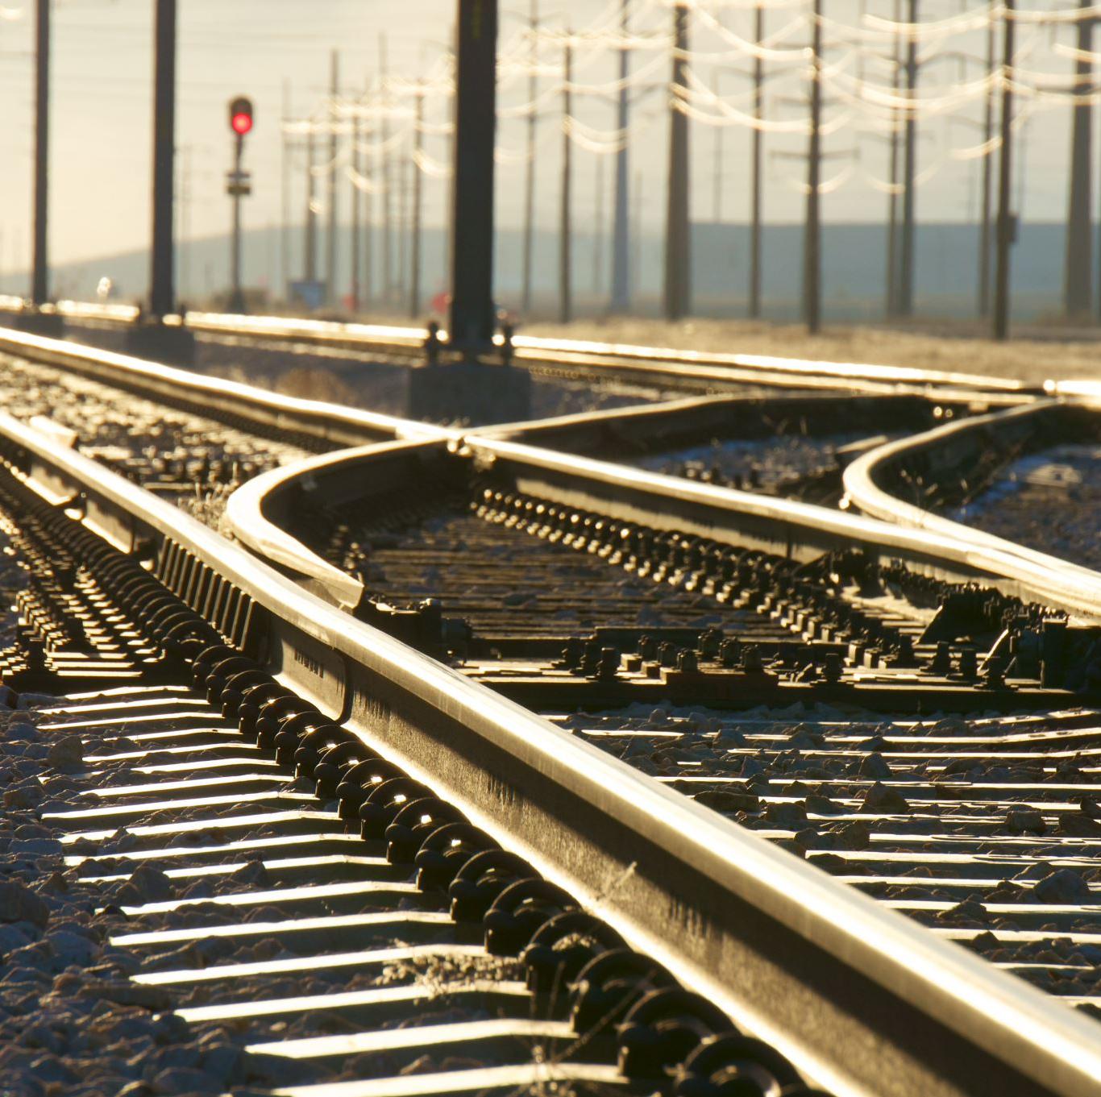
Weathering the Rails
The Impact of Extreme Temperatures and Temperature Changes on Railroad Safety
Notes:
Nathan

Slide 2
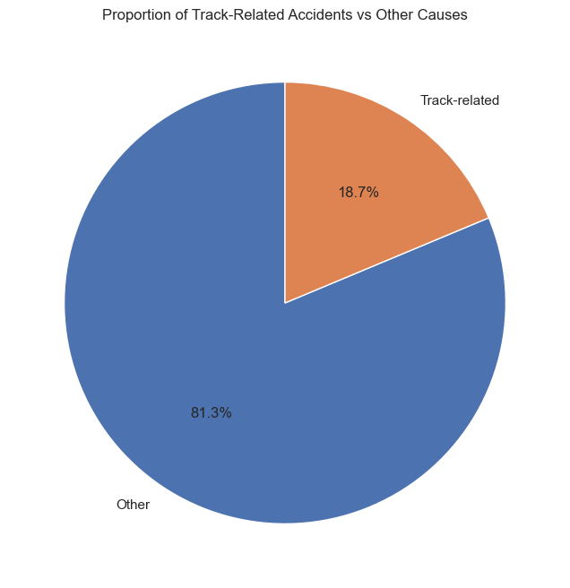
Purpose
Do extreme temperatures and extreme temperature fluctuations contribute to track-related accident/incidents on the railroad?
Track-Related accidents average $208K each and account for 19% of all reportable accident types.
Notes:
Nathan

Slide 3

Key Takeaways
Frequency of events is in slight decline
Most occur between 9am and 5pm, on clear days of moderate temperatures
Can be costly averaging $208K, and max exceeding $22M
Temperature changes greater than ±12˚F are high-risk
Train speeds > 40mph are high-risk
Certain geographic locations are high-risk
Summer and Winter season changes are high-risk
Notes:
Nathan

Slide 4



Data Collection
+
Past 10 Years
Notes:
Nathan

Slide 5
Key Engineered Features for Analysis
before_temp_change
Formula: actual_temp – prior_temp
Represents the temperature change leading up to the incident
after_temp_change
Formula: following_temp – actual_temp
Represents the temperature shift immediately after the incident
across_temp_change
Formula: actual_temp – prior_temp
Captures the overall temperature variability
Notes:
Nathan

Slide 6

Let’s Explore The Data
By Bikram & Andrea
Notes:
Bikrim

Slide 7
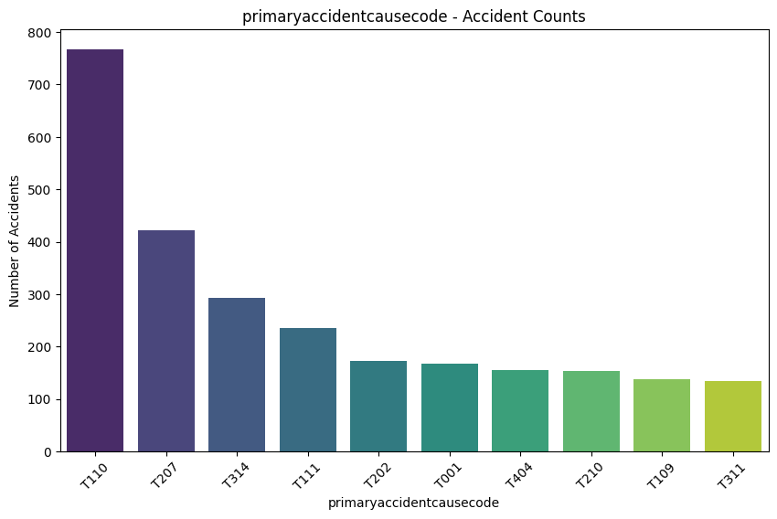
Top Track-Related Incident Causes
T110: Wide gage (defect/missing crossties)
T207: Broken Rail (detail fracture from shelling or head check)
T314: Switch point worn or broken
T111: Wide gage (defective/missing spikes or fasteners)
T202: Broken Rail (base)
T001: Roadbed settled or soft
T404: Catenary system defect
T210: Broken Rail (head and web separation)
T109: Track alignment irregular (buckled/sunk-in)
T311: Switch damaged or out of adjustment
Orange highlighted items could reasonably be related to extreme temperatures and fluctuations over time.
Notes:
Bikrim

Slide 8
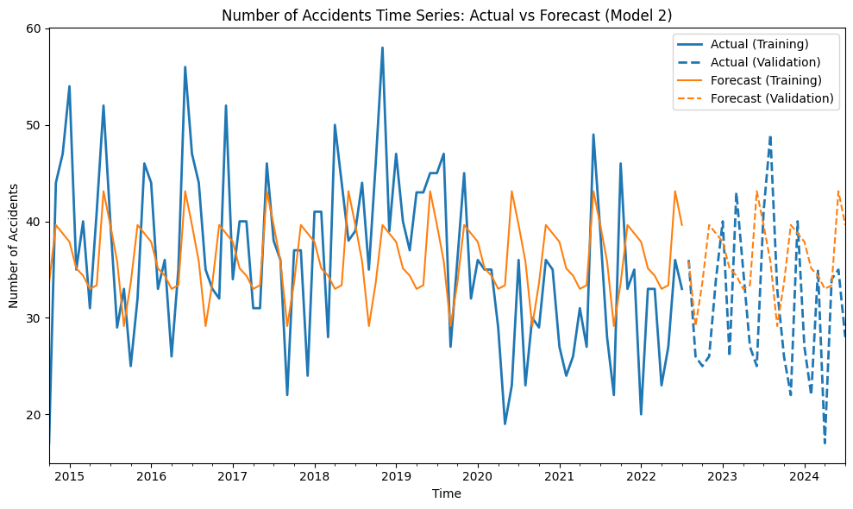
Track-Related Incidents Over Time
Note a slight downward trend over time and into the future.
Notes:
Bikrim

Slide 9
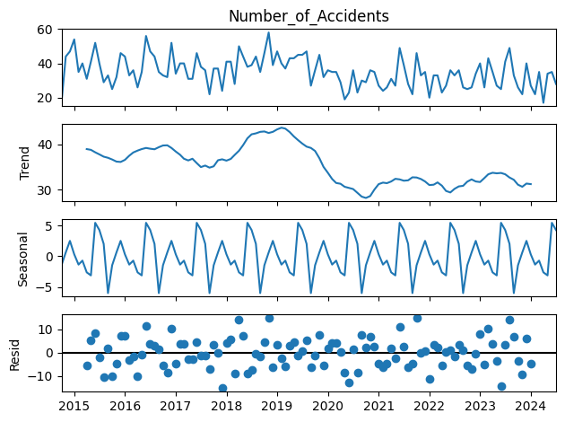
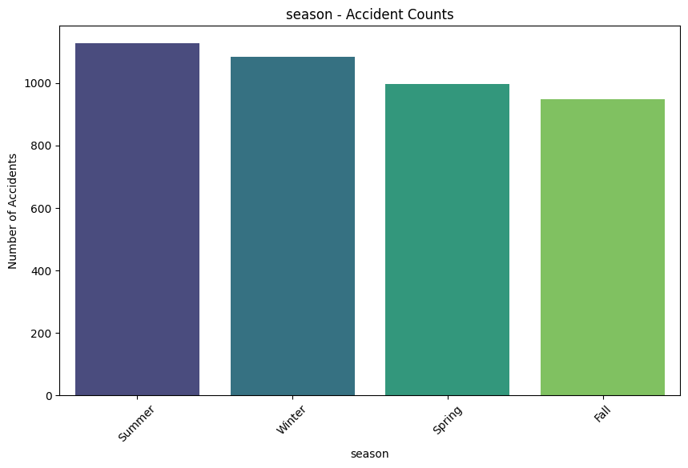
Seasonal Impact
Notes:
Bikrim

Slide 10
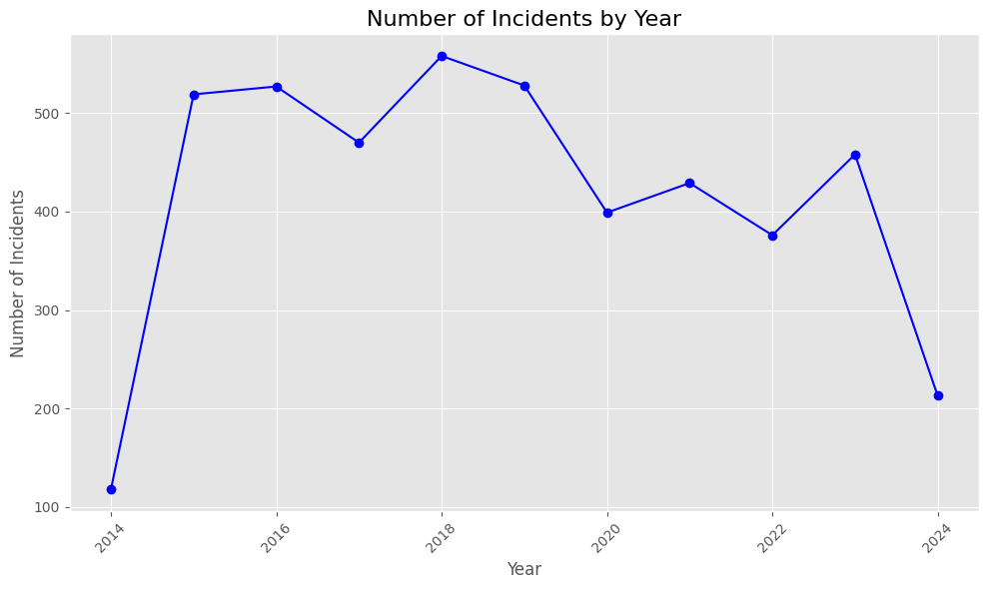
Track-Related Incidents per Year
Notes:
Andrea

Slide 11
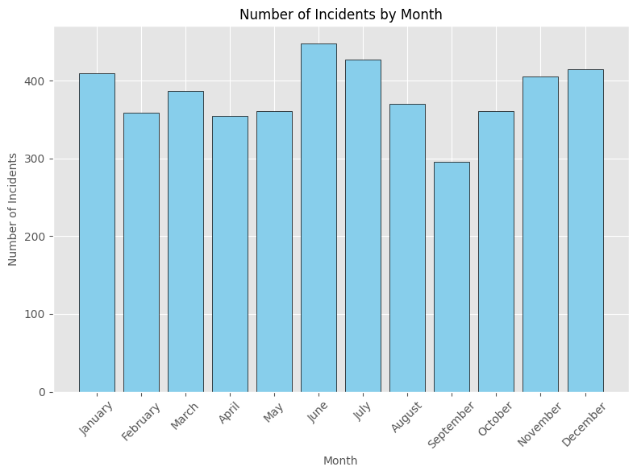
Track-Related Incidents per Month
Notes:
Andrea

Slide 12
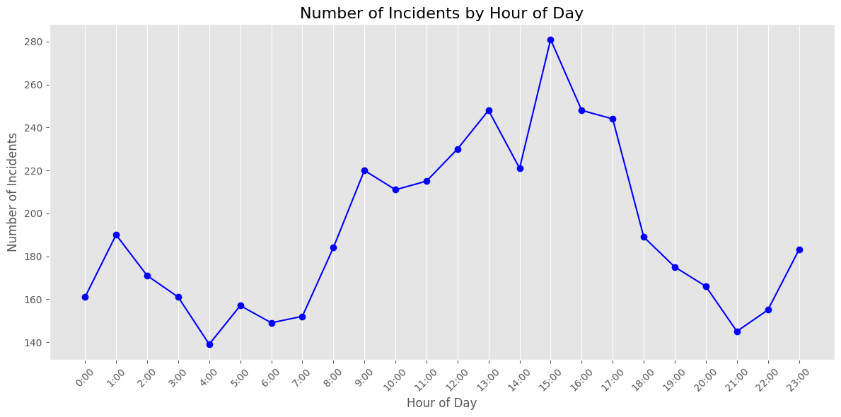
Track-Related Incidents per Hour-of-Day
Notes:
Andrea

Slide 13
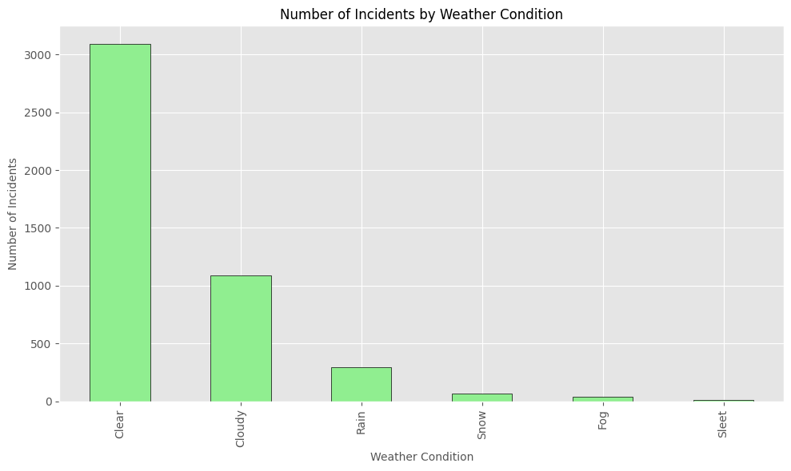
Track-Related Incidents by Weather Condition
Notes:
Andrea

Slide 14

Impacting the Bottom Line
By Sheryl
Notes:
Sheryl

Slide 15
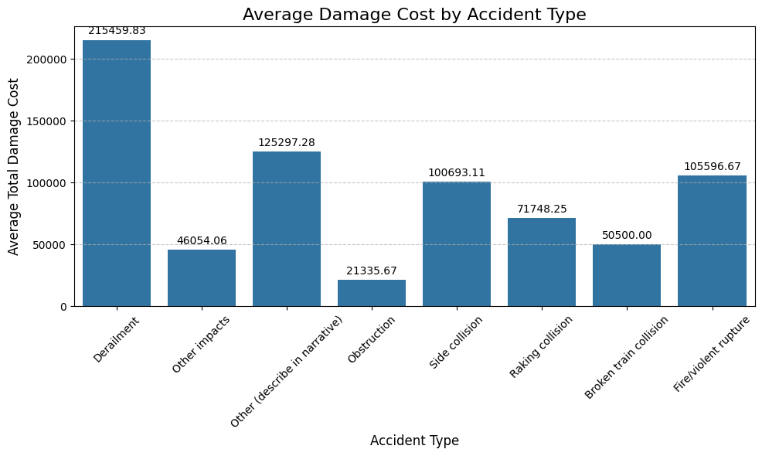
Track-Related Incident Costs by Accident Type
Notes:
Sheryl

Slide 16
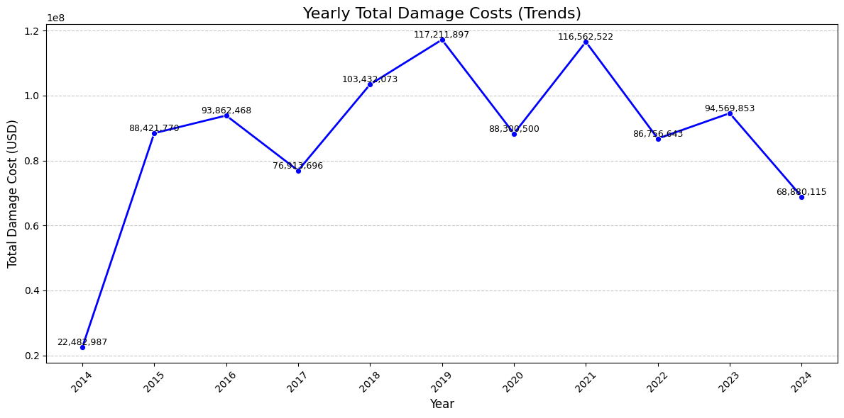
Track-Related Incident Costs Over Time
Notes:
Sheryl

Slide 17
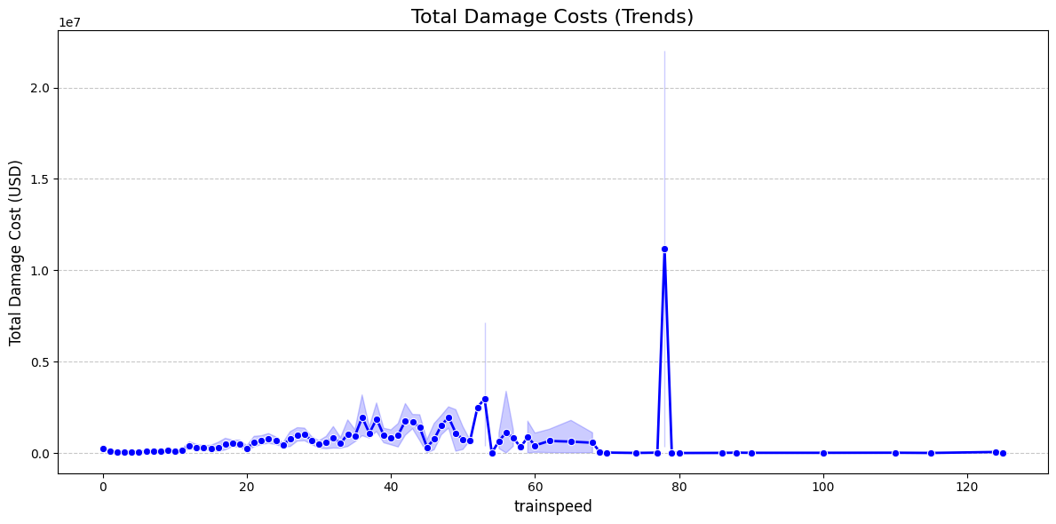
Track-Related Incident Costs by Train Speed
Notes:
Sheryl

Slide 18

Extreme Temperatures and Temperature Changes
By Nathan
Notes:
Nathan

Slide 19
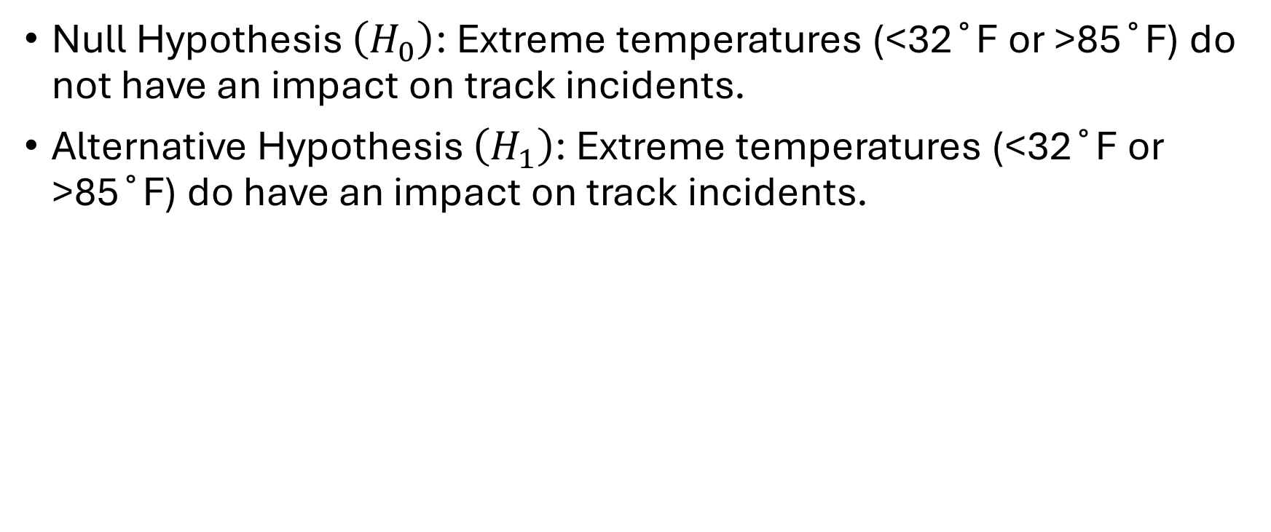
Test Null Hypothesis for Extreme Temperature
Feature | Chi² | P-Value | Null Hypothesis
Below 32˚F | 0.057 | 0.812 | Fail to Reject
Above 85˚F | 1.235 | 0.266 | Fail to Reject
Notes:
Nathan

Slide 20
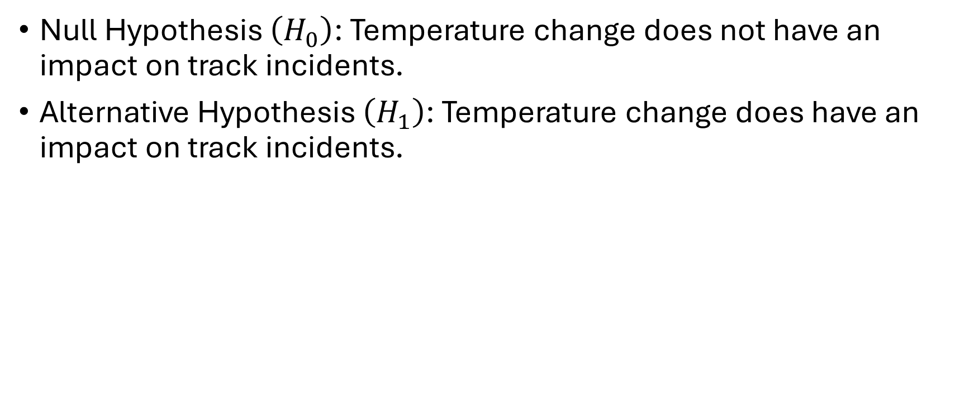
Test Null Hypothesis for Temperature Change
Feature | F-Statistic | P-Value | Null Hypothesis
before_temp_change | 2.754 | 0.097 | Fail to Reject
after_temp_change | 6.149 | 0.013 | Reject
across_temp_change | 0.310 | 0.578 | Fail to Reject
Notes:
Nathan

Slide 21
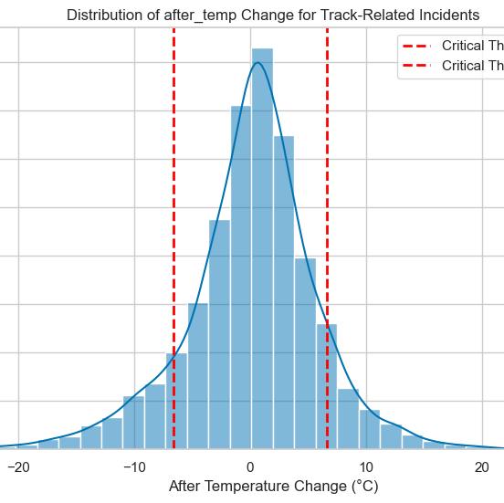
Critical Temperature Change Threshold
± 6.6˚C (12˚F)
10% of Track Accidents
Notes:
Nathan
90% of track accidents occur when there is less than a 12-degree Fahrenheit change.

Slide 22
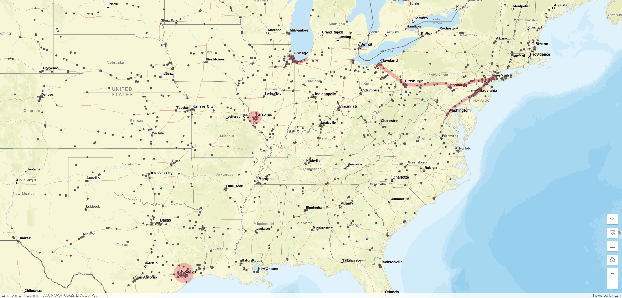
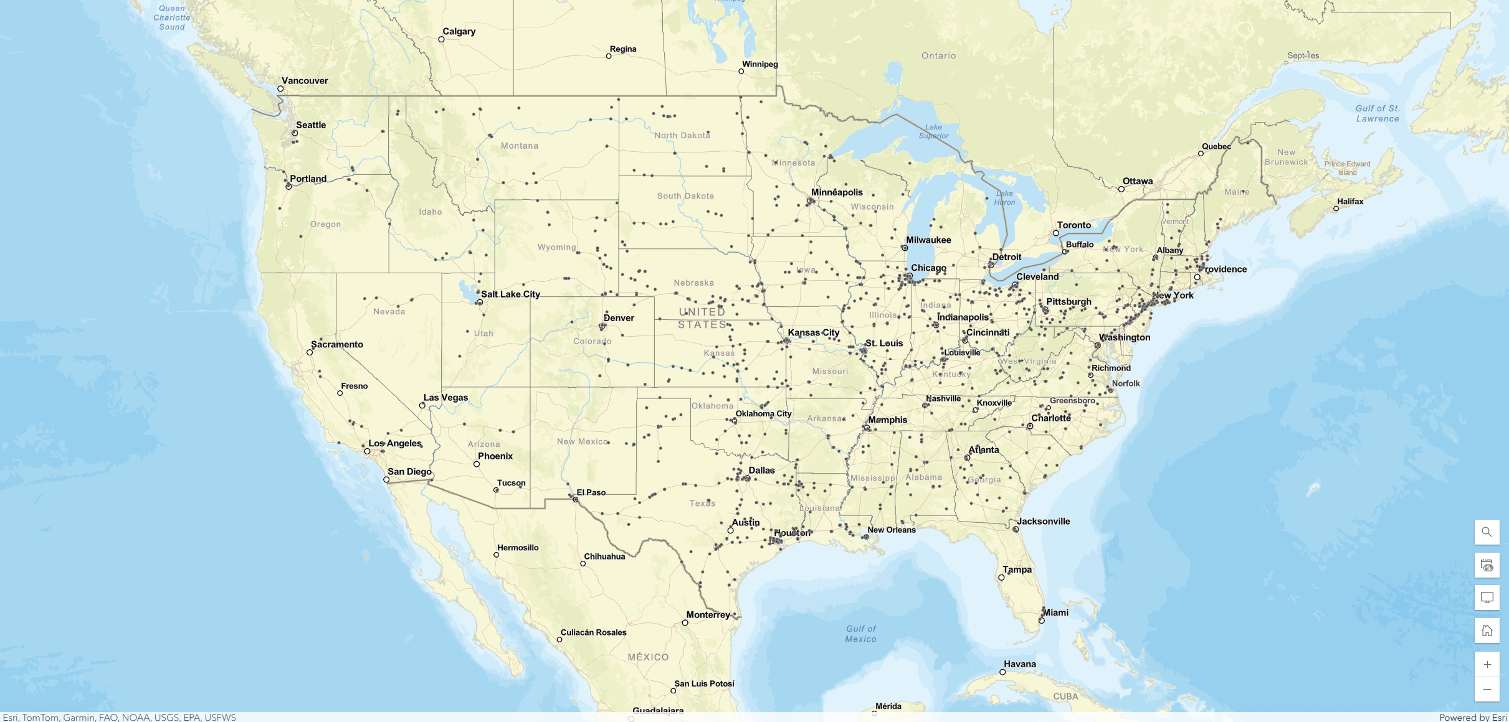
High-Risk Geographic Locations
Notes:
Nathan
Track-related incidents over the past 10 years where the following day’s temperature was + or – 12 degrees F.

Slide 23

Predicting Track-Related Accident Probabilities
By Yash
Notes:
Yash

Slide 24
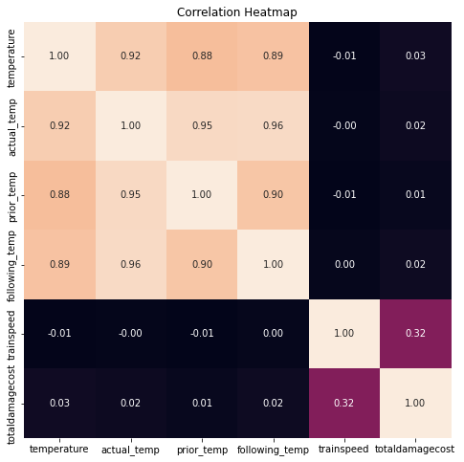
Important Features
Temperature volatility (highest importance)
Actual temperature (second highest)
Train speed (moderate importance)
Notes:
Yash

Slide 25
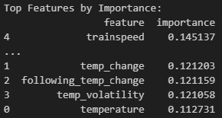
Critical Factors
Sudden temperature changes correlate with increased accidents
Extreme temperatures show higher risk patterns
Volatility is more significant than absolute values
Notes:
Yash

Slide 26
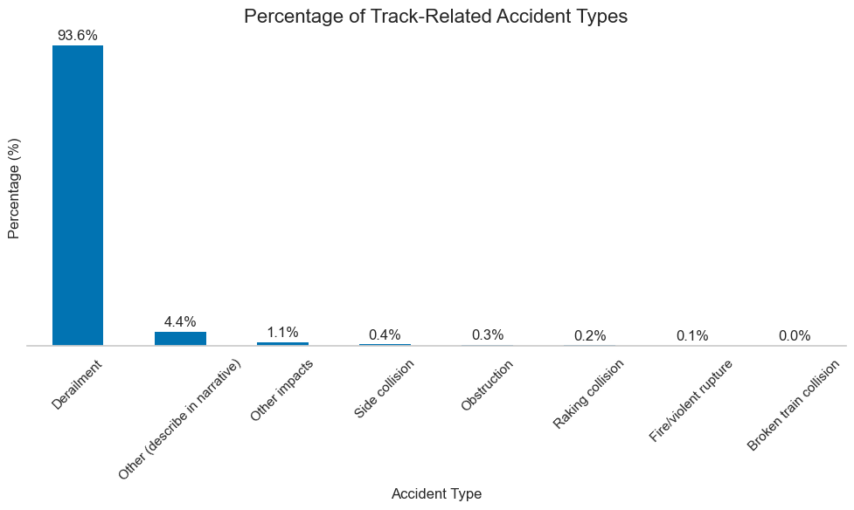
High-Risk Conditions
Temperature changes >10˚F have a 2x accident probability
Train speeds >40mph with temperature variations
Spring and Fall transitions bring seasonal risk peaks
Notes:
Yash

Slide 27
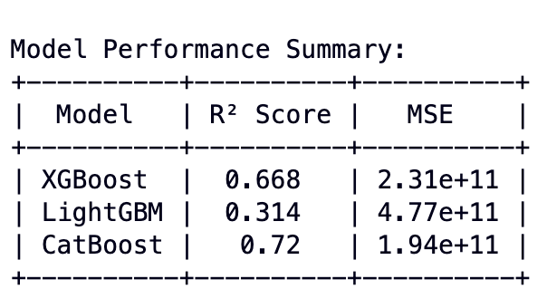
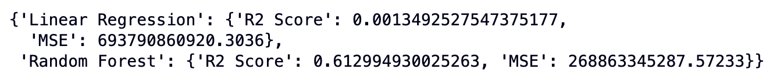
Modeling I: Predicting the total damage cost based on the temperature parameters.
Notes:
Yash

Slide 28
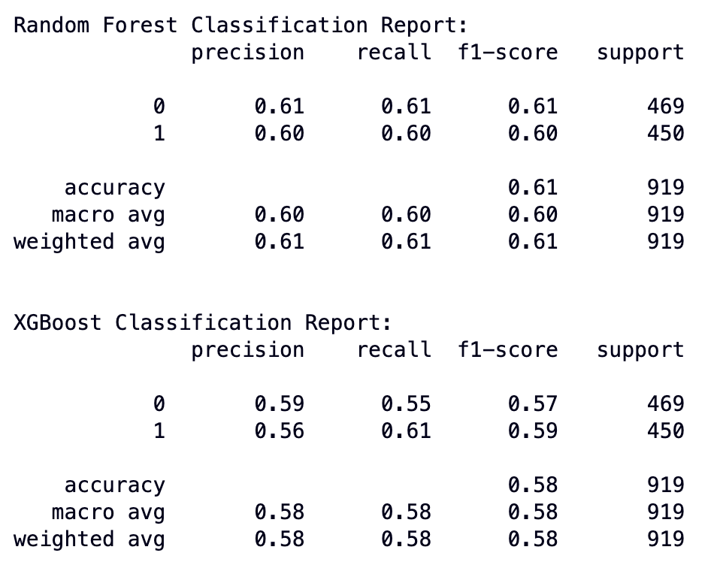
Modeling II: Predicting the accident probability based on temperature changes and other factors.
Notes:
Yash

Slide 29

Recommendations
Railroads should continue their current track maintenance best practices
Railroads should perform more frequent and enhanced track inspections for:
Areas where weather forecasts predict a temperature change of ±12˚F
High-risk cities such as Houston, St Louis, Chicago, New York City, and Philadelphia
Key high-risk rail routes, particularly the corridor from Cleveland through New York City to Washington DC
On track designated for speeds > 40 mph
During seasonal transitions into Spring and out of Fall
Notes:
Nathan

Slide 30

Questions?
Notes:
Nathan

Slide 31
References
Transportation, U. D. (n.d.). Transportation data: National Highway Traffic Safety Administration [Data set]. Retrieved October18, 2024, from https://data.transportation.gov/resource/85tf-2kj.json
U.S. Department of Transportation, F.R. (2011). FRA Guide for Preparing Accident/Incident Reports. Retrieved October 18, 2024, from https://railroads.dot.gov/sites/fra.dot.gov/files/fra_net/18233/FRAGuideforPreparingAccIncReportspubMay2011.pdf
Weather, V. C. (n.d.). Visual crossing web services timeline [Data set]. Retrieved October 20, 2024, from https://weather.visualcrossing.com/VisualCrossingWebServices/rest/services/timeline/{location}/{start_date}/{end_date}
Esri. (n.d.). ArcGIS Online. Environmental Systems Research Institute. https://www.arcgis.com

